Slide 1
Video Action Recognition In Synthetic Soccer Games
SCIENTIFIC COORDINATOR
Conf. Dr. Alexe Bogdan
STUDENT
Petrișor-Ionuț Calofir

Slide 2
Introduction
Generated a synthetic soccer dataset
Used video action recognition in soccer
Recognize the activity from a group of players interacting with each other (e.g. shot, pass)
Summarize an entire match and show only the important events
Predicted the goal probability of a shot only from images or videos

Slide 3
Synthetic Dataset
Motivation
Currently there are few datasets available
Does not require manual annotation
Flexibility in creating various scenarios and many more videos in a short time
Used the engine from Google Brain which simulates an entire soccer match
Initially released to be used for Reinforcement Learning
Modified the engine and created three classes: pass, shot and no action

Slide 4
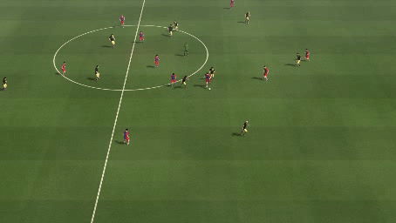
Synthetic Dataset
Pass action
Occurs when a player performs a pass and the ball reaches another player from his team or from the opposing team or it goes out of play
Figure 1. Pass Action

Slide 5
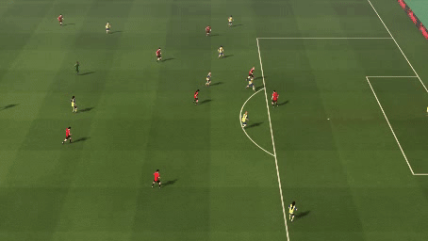
Synthetic Dataset
Shot action
Occurs when a player performs a shot and the ball travels a certain distance until is blocked by another player or goes out of play
Figure 2. Shot Action

Slide 6
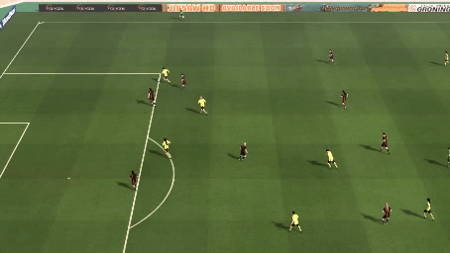
Synthetic Dataset
No action
The no action class contains videos of different lengths randomly chosen from the match which are different from the ones present in the pass and shot classes
Figure 3. No Action

Slide 7
Synthetic Dataset
A total of 1049 simulated games
Each game has approximately 3000 frames and is displayed at 10 frames per second
A total of 135591 generated videos having a duration of 59 hours
Class | Number of examples
Pass | 83828
Shot | 8456
No Action | 43849
Table 1. Dataset

Slide 8
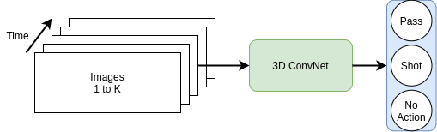
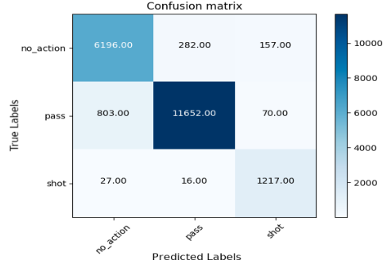
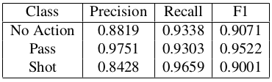
Video Action Recognition
Figure 4. I3D Architecture
Recognize the activity from a group of players interacting with each other (e.g. shot, pass)
Used the I3D architecture with inflated ResNet-50
The network was pretrained on a much larger dataset called Kinetics-400 and then finetuned on the synthetic dataset
The network achieves a good performance for all three classes
Table 2. Results on the test set
Figure 5. Confusion Matrix for the test set

Slide 9
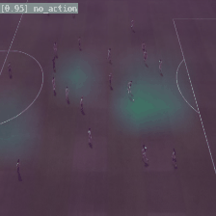
Video Action Recognition
Figure 6. No Action
Visualization using Grad-CAM
Grad-CAM is a method for visualizing the activations from a specific convolutional layer when predicting a certain class
No action
The activations are present on the entire frame which is a strong indication that there is no event happening

Slide 10
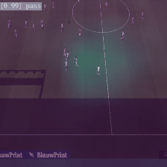
Video Action Recognition
Figure 7. Pass Action
Pass action
The network focuses especially on the ball and the players involved in this action

Slide 11
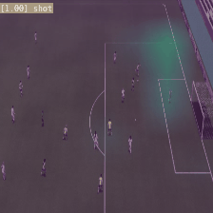
Video Action Recognition
Figure 8. Shot Action
Shot action
The network focuses on the ball and the region around the goal because the shots usually happen in that region

Slide 12
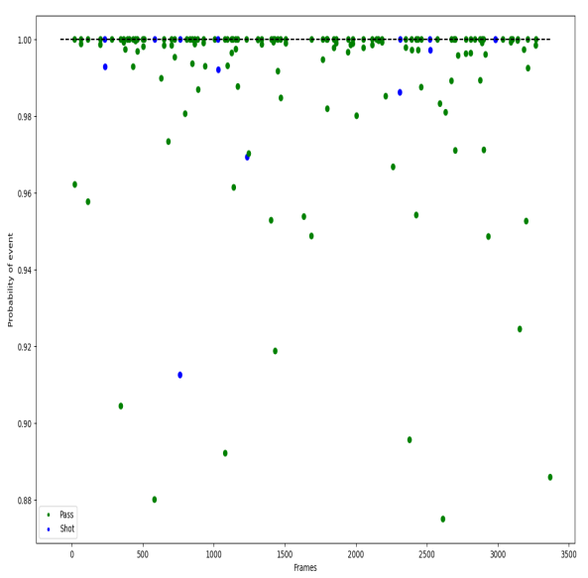
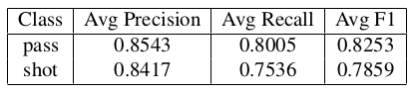
Video Action Recognition
Figure 9. Example of highlight detection of an entire soccer match
Highlight Detection
Extract the events from an entire soccer match
Predict the event for every frame
Eliminate multiple detections of a single event using non-maximum suppression (NMS)
Table 3. Results on the test set consisting of 30 soccer matches

Slide 13
Expected Goals
Predict the goal probability of a shot only from images or videos
Train a network using images
Used the ResNet-50 architecture pretrained on ImageNet
The image taken just as the player is shooting
Train a network using short videos
Used the I3D architecture with inflated ResNet-50
The video starts with 20 frames before the shot and ends exactly when the player touches the ball to shoot
The model trained on short videos performed better than the model trained on images
Model | AUC-PR | AUC-PR Random
Video | 0.3375 | 0.2277
Image | 0.2858 | 0.2277
Table 4. Results on the test set consisting of 30 soccer matches

Slide 14
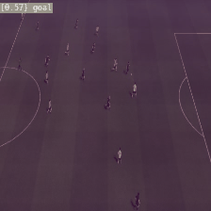
Expected Goals
Figure 10. Example for the Expected Goals task
An example for the Expected Goals task
The model predicts that the shot will be a goal with probability p=0.57

Slide 15
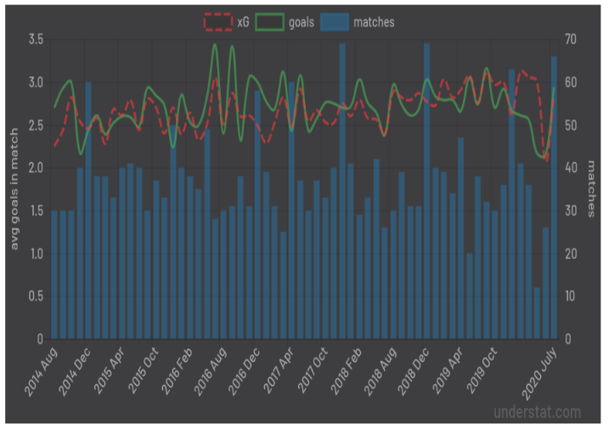
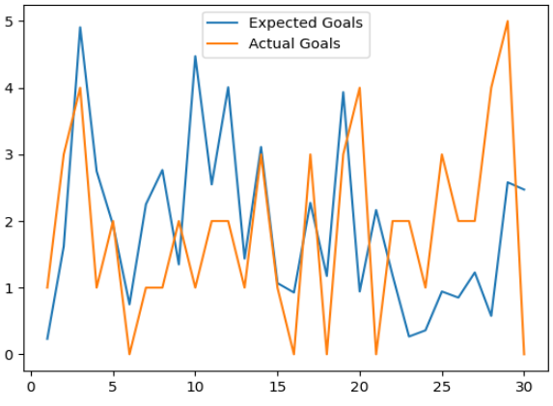
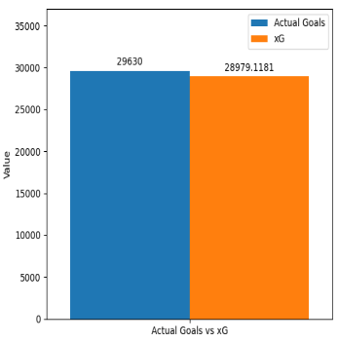
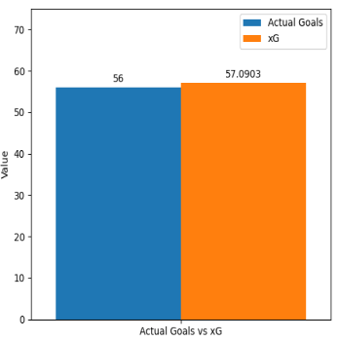
Expected Goals
Figure 11. Understat model
A better way to evaluate if the model trained for the Expected Goals task have a good performance is to sum the probabilities of every shot from a soccer game and compare it with the actual number of goals
These values should be close over a large number of games
Figure 13. Understat model
Figure 14. Our model tested on 30 matches
Figure 12. Our model tested on 30 matches

Slide 16
Conclusions
Presented a way to generate a synthetic dataset for soccer
Showed that video action recognition can be applied successfully on synthetic soccer videos and presented a method to summarize an entire soccer match
Investigated two approaches for predicting the goal probability from a shot using images or short videos

Slide 17
Thank you!

